Slide 1
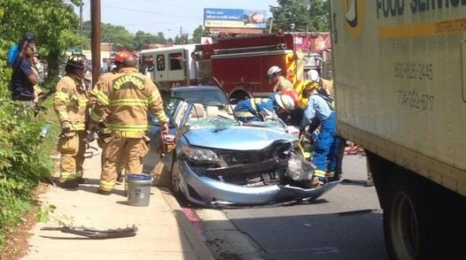
GSBO city collision data analysis
-Vanteru Sahithi
-Jorge Salas
-Daniel Frye
-Jin Kang
-Dimithra Rathnayake
Notes:
Image from https://myfox8.com/2014/05/27/car-crashes-underneath-truck-blocks-traffic-on-battleground-ave/

Slide 2
Introduction
Our project is to analyze collisions data of Greensboro city and find insights from the data.
To know the correlation between various elements that cause accidents, identify patterns in order to help the city of Greensboro reduce the number of fatalities from vehicular incidents.

Slide 3
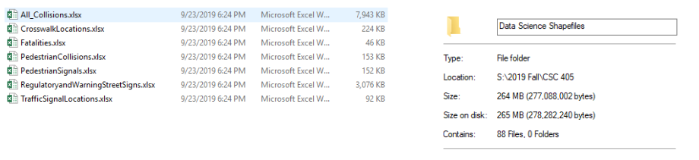
Data
We have 2 categories of raw data, one that has comma separated values and the other one that has geo spatial data in the form of shape files.
The CSV files has all the information about about collisions like date, place, number of fatalities, severity of the accidents and so on.
Data statistics - 11,686 kb - CSV files , more than 80 shapefiles(geo spatial data)

Slide 4
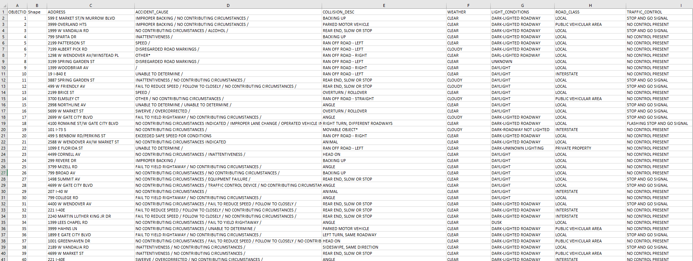
Snapshot of the data

Slide 5
Goals
Sahithi - Poisson distribution between accidents on weekends and weekdays and time intervals ,hypothesis testing , Prediction of accidents based on time series data,random forest classification based on weather attributes.
Jin - Investigate the relationship between Greensboro population and collision. Analyze the number of collisions with Greensboro population across blocks designed by the Census
Jorge-Distribution of alcohol across fatalities in greensboro. Analyzing distribution of fatality frequency due to time of day. Analysis of distribution of Fatality Frequency due to month of year. Analysis of Distribution of Fatality Frequency due to specific year.
Dimithra - Identify pedestrian collision hotspots and contributing factors.
Daniel - Visualization of the data, mapping with plotly and folium to create interactive maps.

Slide 6
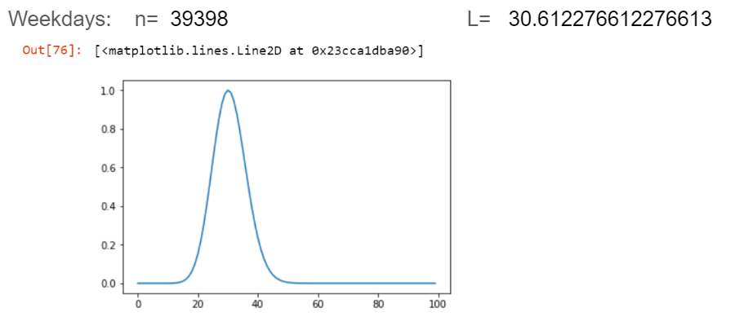
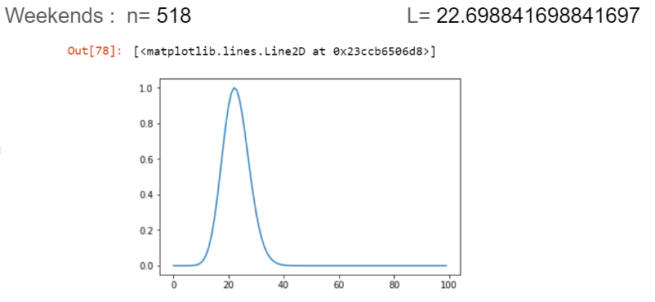
Distribution between weekdays and weekends.

Slide 7
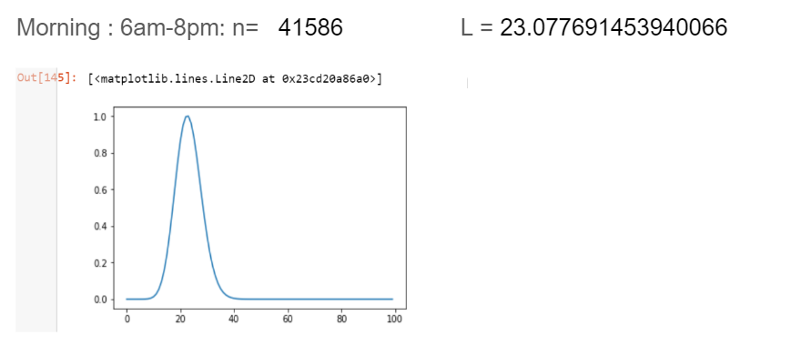
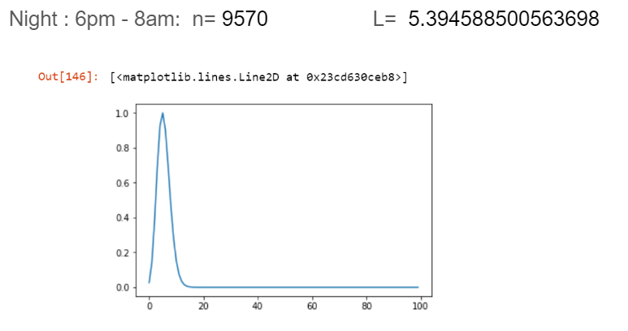
Distribution between time intervals.

Slide 8
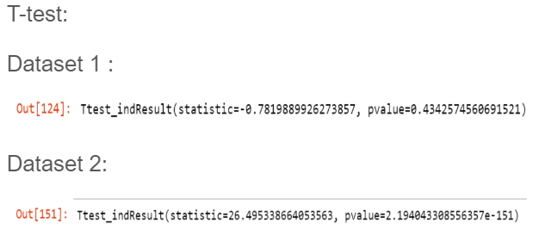

Slide 9
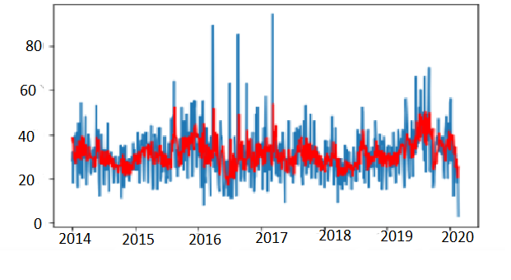
training - 66% data,testing - 34% data.
Predicted trends for years 2019 and 2020.
Accuracy - 69.80%

Slide 10
The weather has severity levels on scale of 1 to 10.
Predicted the type of weather that caused accidents.
Trained data- 75%, test data - 25%.
Compared with KNearest classifier and decision tree classifier. The accuracies are shown below.

Slide 11
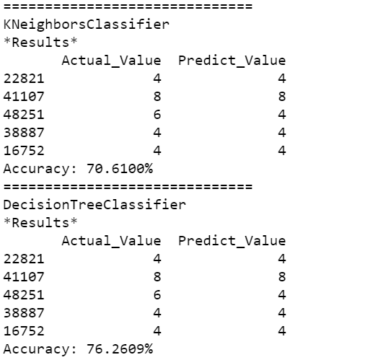
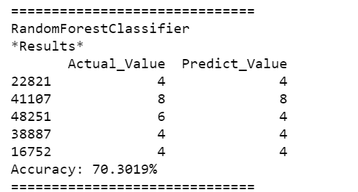

Slide 12
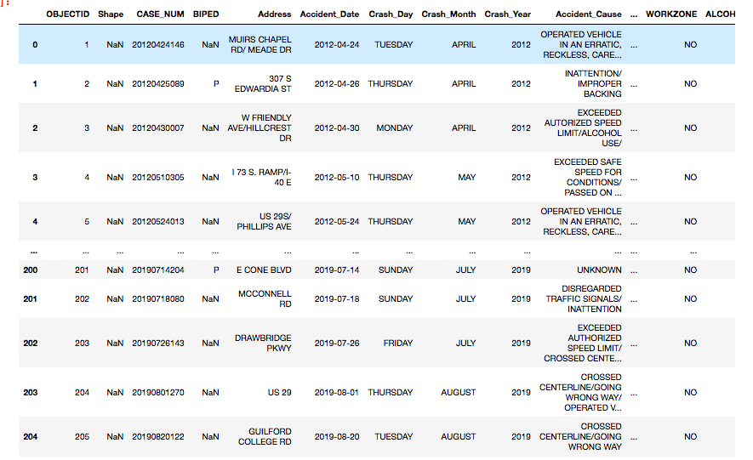
Data Snapshot of Fatalities csv data

Slide 13
Questions
How do fatalities look like over the years?
How do fatalities look like per month?
How do fatalities look like over the time of day?
Does it seem as if alcohol played a roll with the collisions?
Objective: To answer these questions and to determine the main factor of that caused these collisions.
Tasks: These questions were also my tasks, attempts to analyze the other data were attempted but were a lot more difficult given time constraints

Slide 14
Methodology
Using pandas dataframes to quickly and effectively analyze the data
Cleaning and separation of data to seperate parts
Hardwork
These methods were used because they were the most effective when dealing with tables of data
Tasks: These questions were also my tasks, attempts to analyze the other data were attempted but were a lot more difficult given time constraints. Machine learning model was unsuccessful due to scope of data.

Slide 15
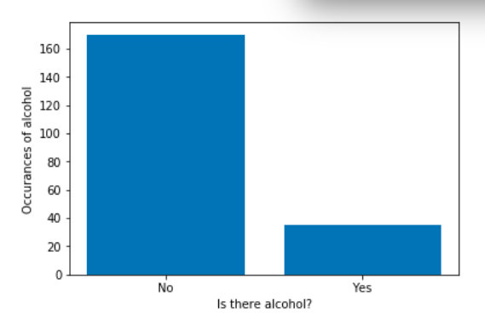
Distribution of alcohol across fatalities in greensboro

Slide 16
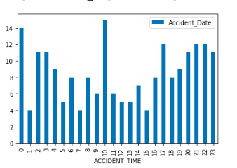
Analyzing distribution of fatality frequency due to time of day

Slide 17
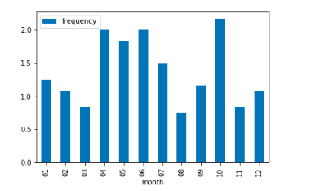
Analysis of distribution of Fatality Frequency due to month of year

Slide 18
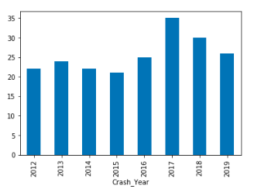
. Analysis of Distribution of Fatality Frequency due to specific year

Slide 19
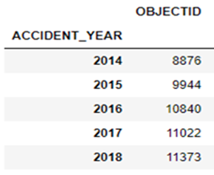
Greensboro Population vs Collision
Overview of Greensboro population and collision over last 5 years
Greensboro population Greensboro Collision
Year | Population
2014 | 282,476
2015 | 285,034
2016 | 287,018
2017 | 290,222
2018 | 294,722

Slide 20
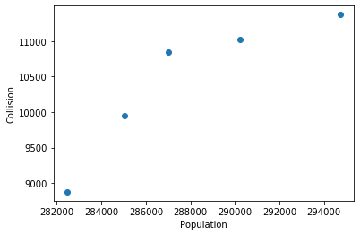
GSBO Population vs Collision
Poisson Distribution(𝜆)
𝜆 = n*θ where n is the number of sample and θ is the probability. 𝜆 is the mean and variance of the number of collisions in each year
We can see the increase of the number of collisions over years.
Year | Collisions per 1,000 people
2014 | 31.42
2015 | 34.89
2016 | 37.77
2017 | 37.98
2018 | 38.59

Slide 21
Relationship between population and collision
Question: Is population a factor of collision in Greensboro? (Is there any relationship between population and collision?)
I was given 52055 points (collision data) and 292 blocks which belong to Guilford county (population data).
H0: There is no relationship between the Greensboro population and collision
Ha: There is a relationship between the Greensboro population and collision

Slide 22
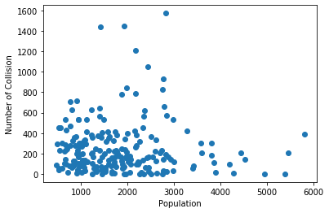
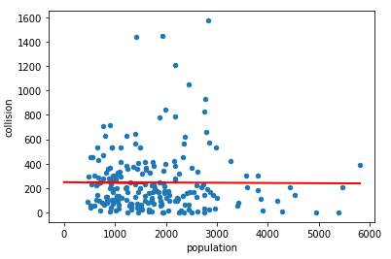
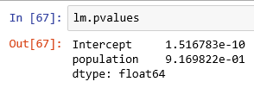
Relationship between population and collision
Once I removed blocks outside of Greensboro, I had a scatter plot like below:
Since the p-value (0.916) is larger than 0.05, we failed to reject the null hypothesis.
Thus, there is no relationship between population and collision.

Slide 23
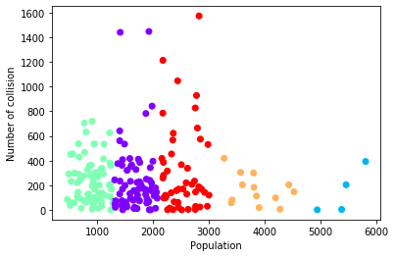
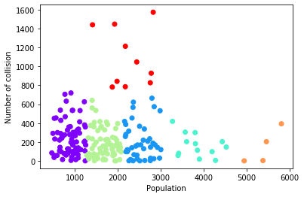
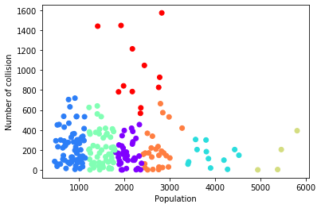
Dashboard Result (Clustering)
Question: Based on population, which areas are more likely to have collision?
By clustering, I wanted to capture points that have enough population and high number of collision.
Each one is generated when KMeans = 5, 6, and 7, respectively.
I thought clustering method captured the points well when KMeans = 6.

Slide 24
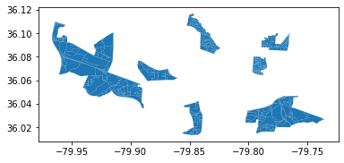
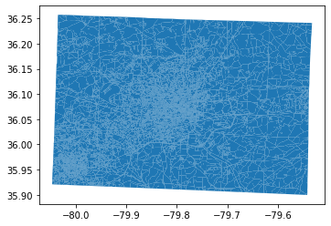
Dashboard Result
The right plot shows the captured points. In Greensboro, these areas are more likely to have collisions based on population.

Slide 25
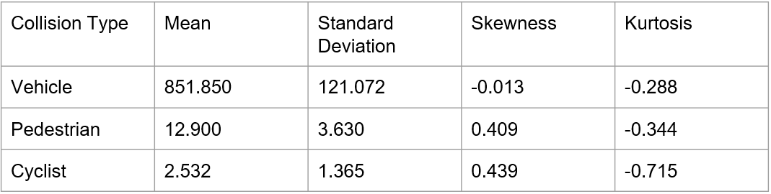
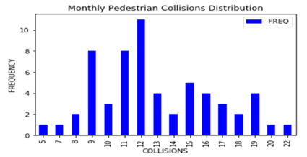
Basic Statistics
Monthly Collisions

Slide 26
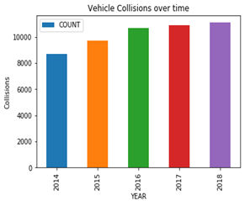
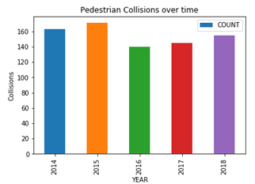
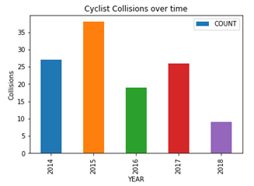
Collisions Over Time
Correlation Coefficients:
Vehicle Collisions: 0.94
Pedestrian Collisions: -0.52
Cyclist Collisions: -0.71

Slide 27
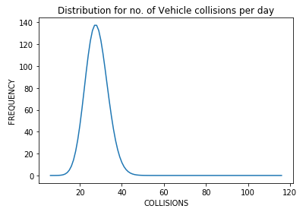
Distribution of Collisions per Day
Collisions within a day
Vehicle: Poisson (27.99)
Pedestrian: Poisson (1.27)
Cyclist: Poisson (1.08)

Slide 28
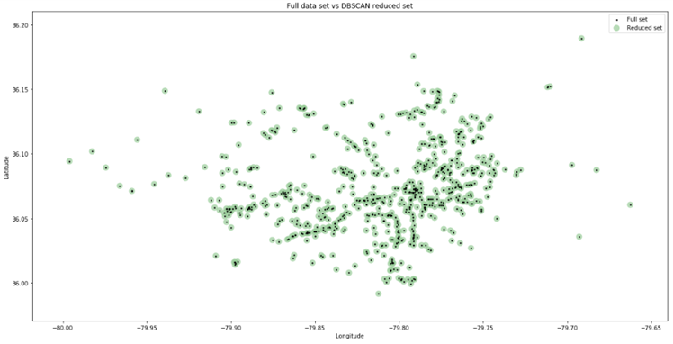
Unsupervised Learning
Clustering - DBSCAN

Slide 29
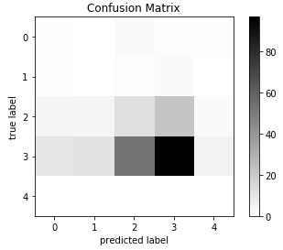
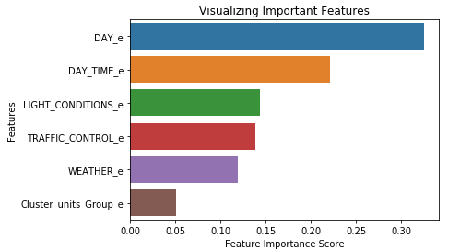
Supervised Learning
Factor relation to severity - Random forest classification
Accuracy - 0.48
Precision - 0.65
Recall - 0.48

Slide 30
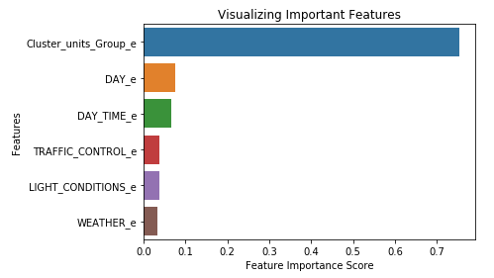
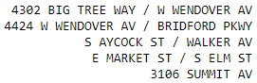
Supervised Learning
Factor relation to collision count - Random forest regression
R-squared: 0.70
Root mean squared error: 0.75
Mean squared error: 0.57

Slide 31
Mapping The Data
The data primarily used to in this process was over all collisions in Greensboro, NC.
The tools utilized was MapBox API, Plotly.py, and folium

Slide 32
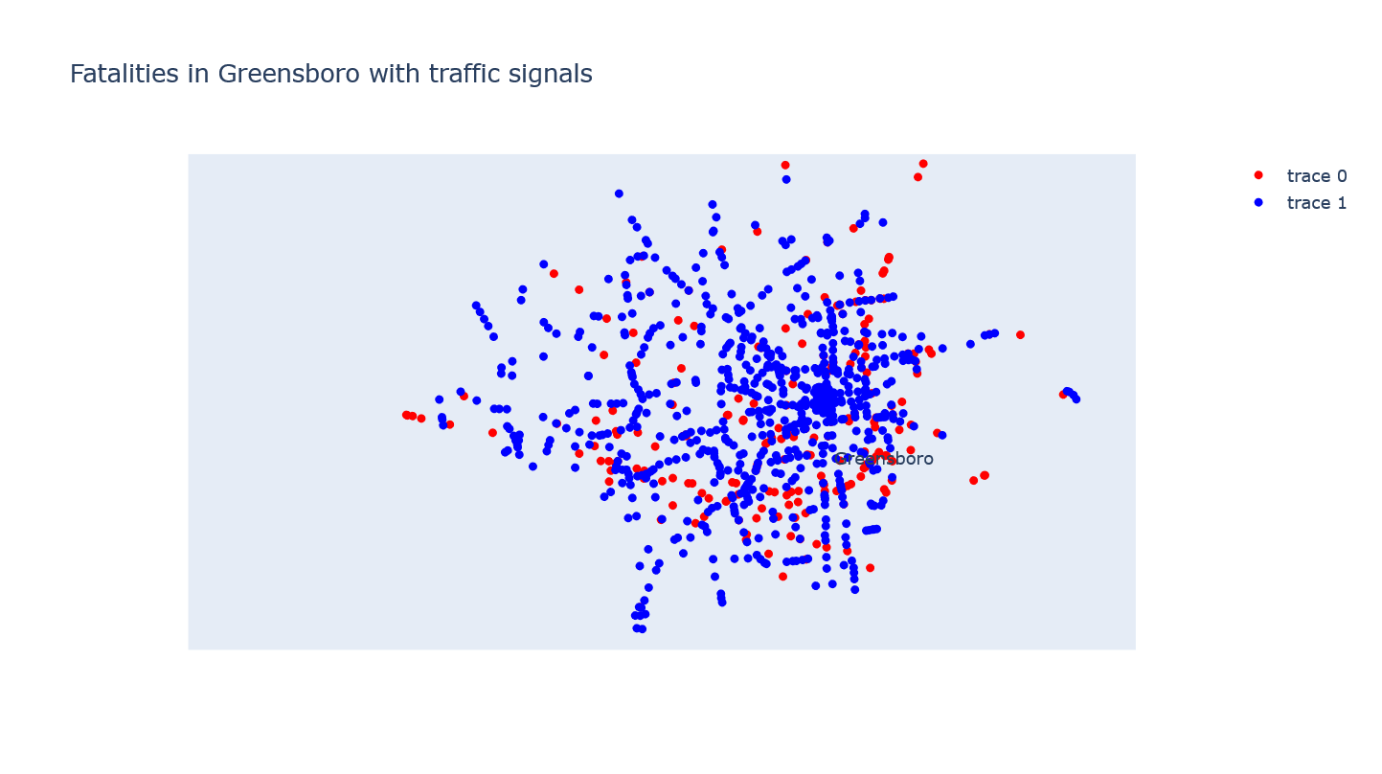
Plotting with Plotly.py

Slide 33
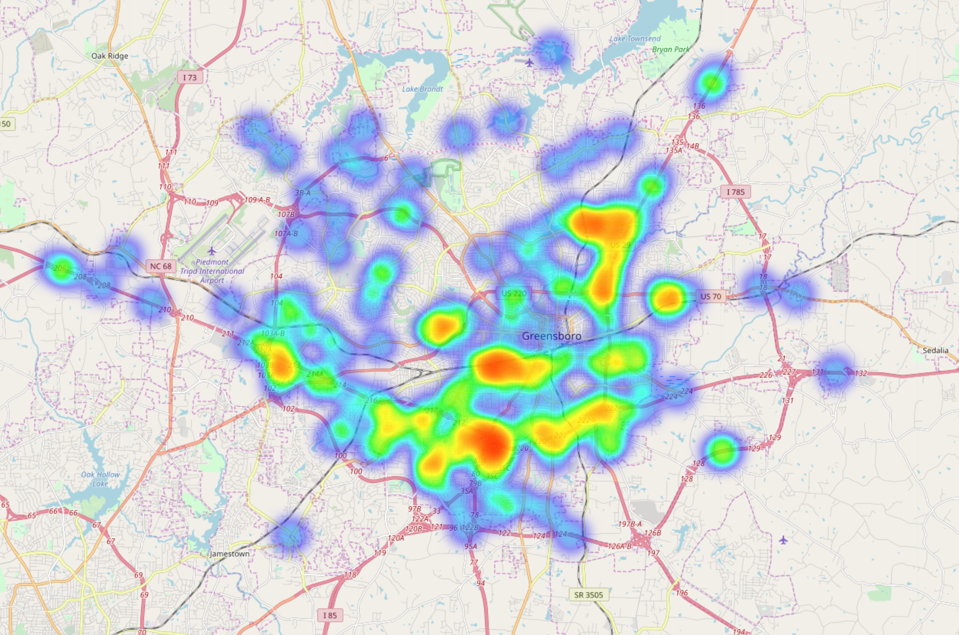
Fatalities in Greensboro Heat Map

Slide 34
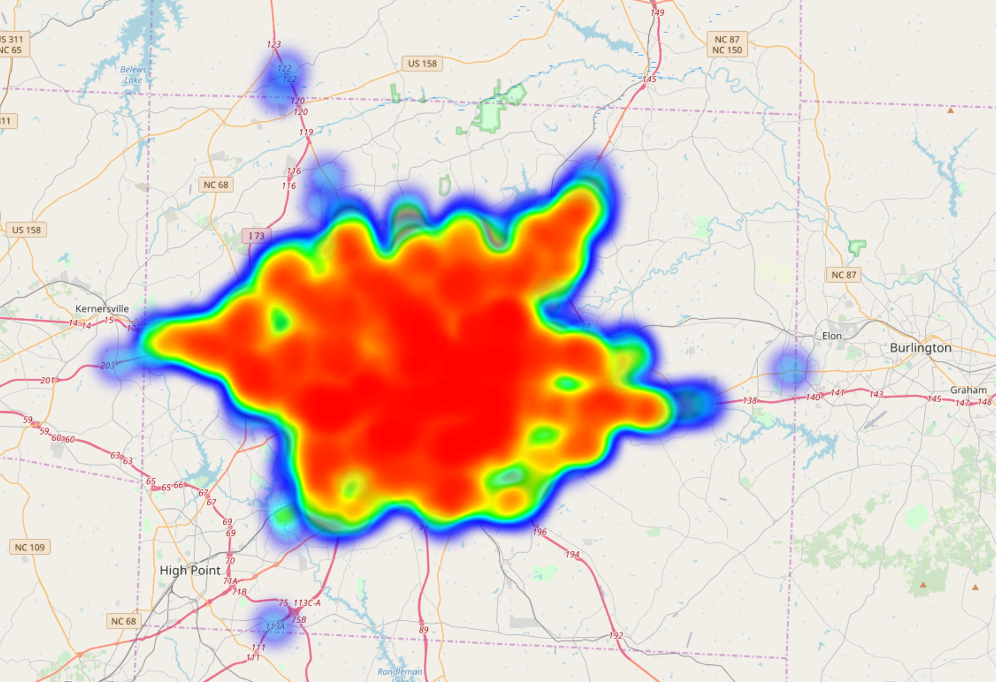
Layered Map of All Collisions in Greensboro
2014 to 2018

Slide 35
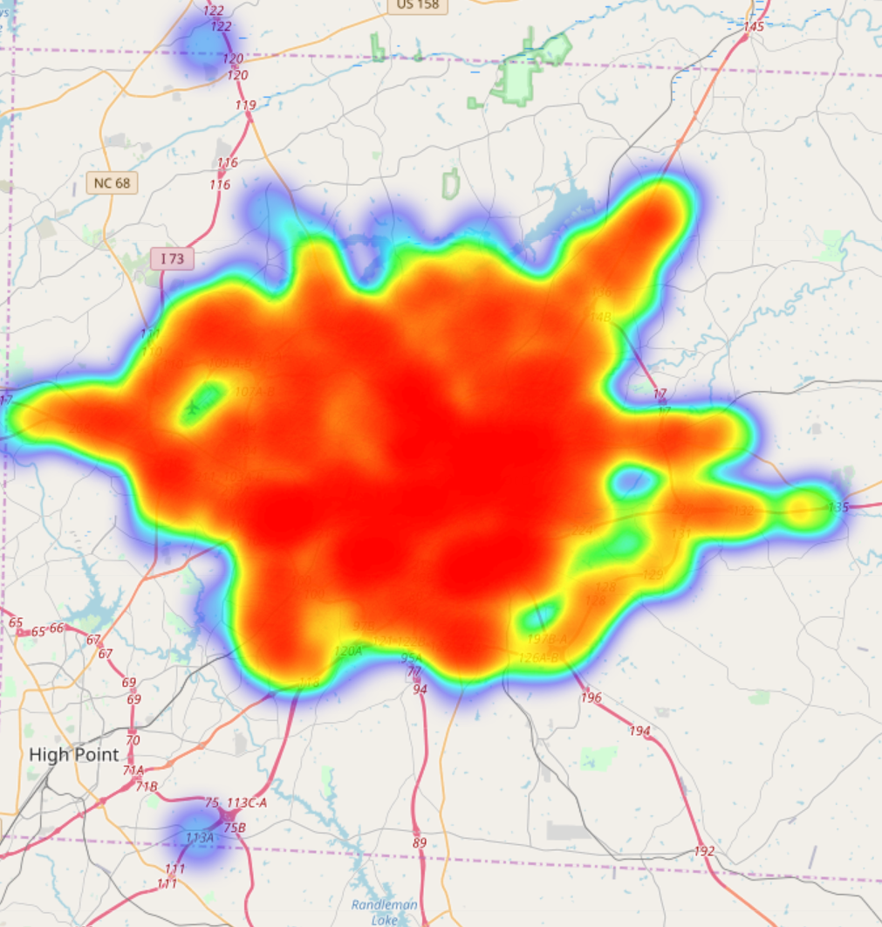
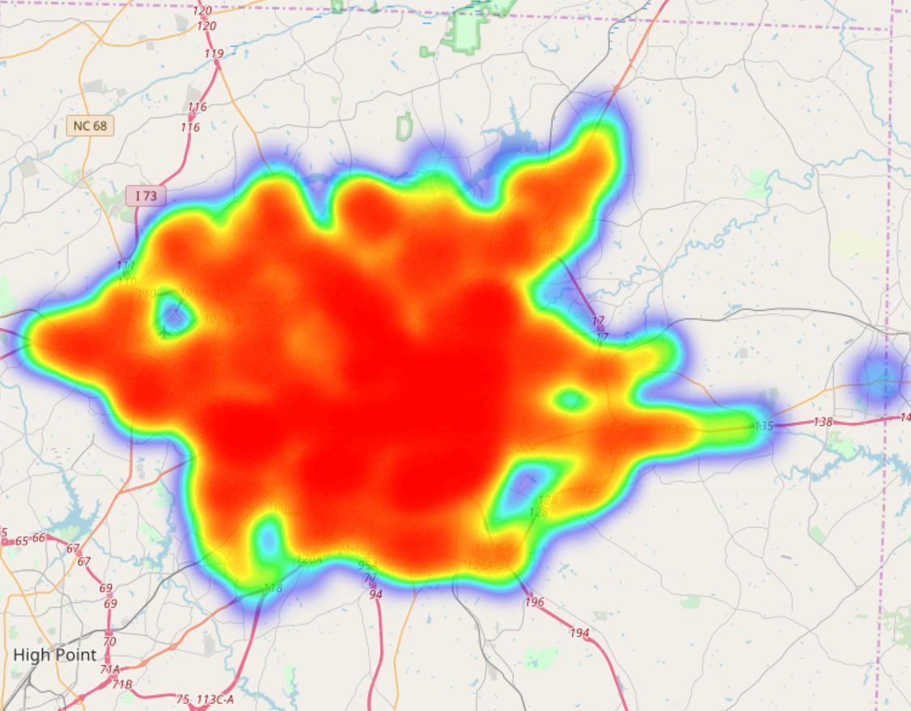
Collisions:2014 and 2015

Slide 36
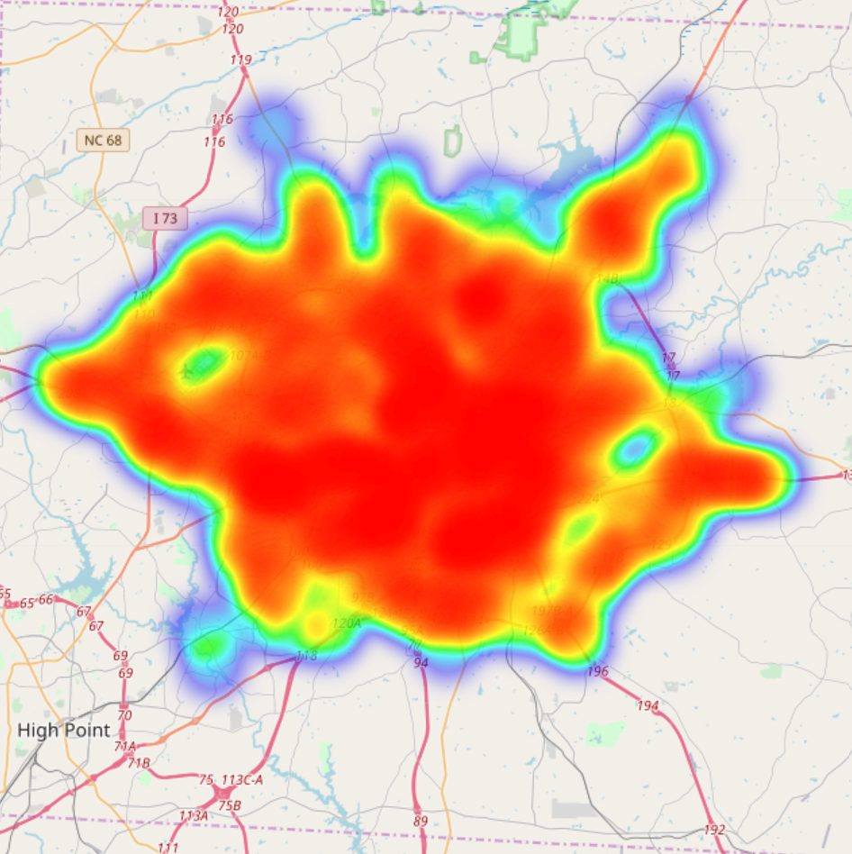
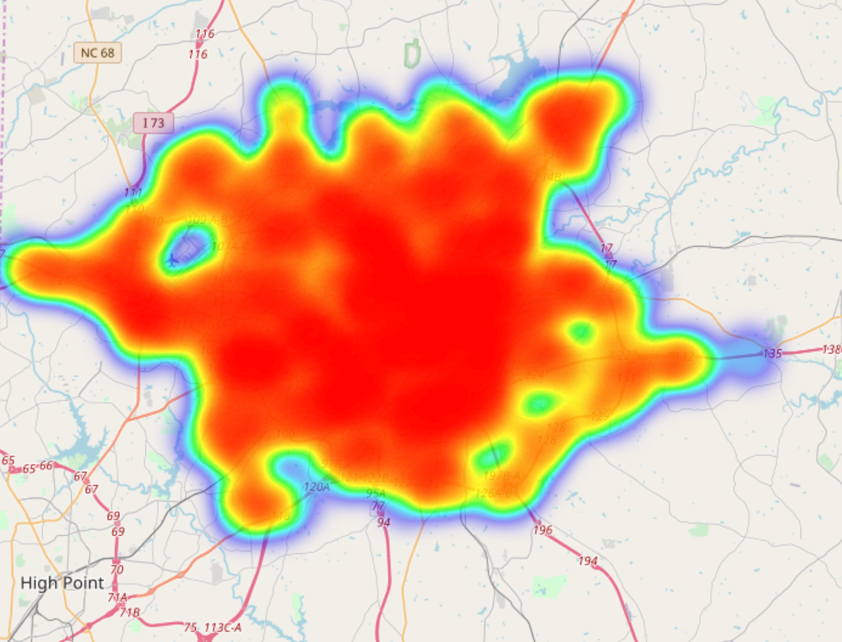
Collisions:2016-2017

Slide 37
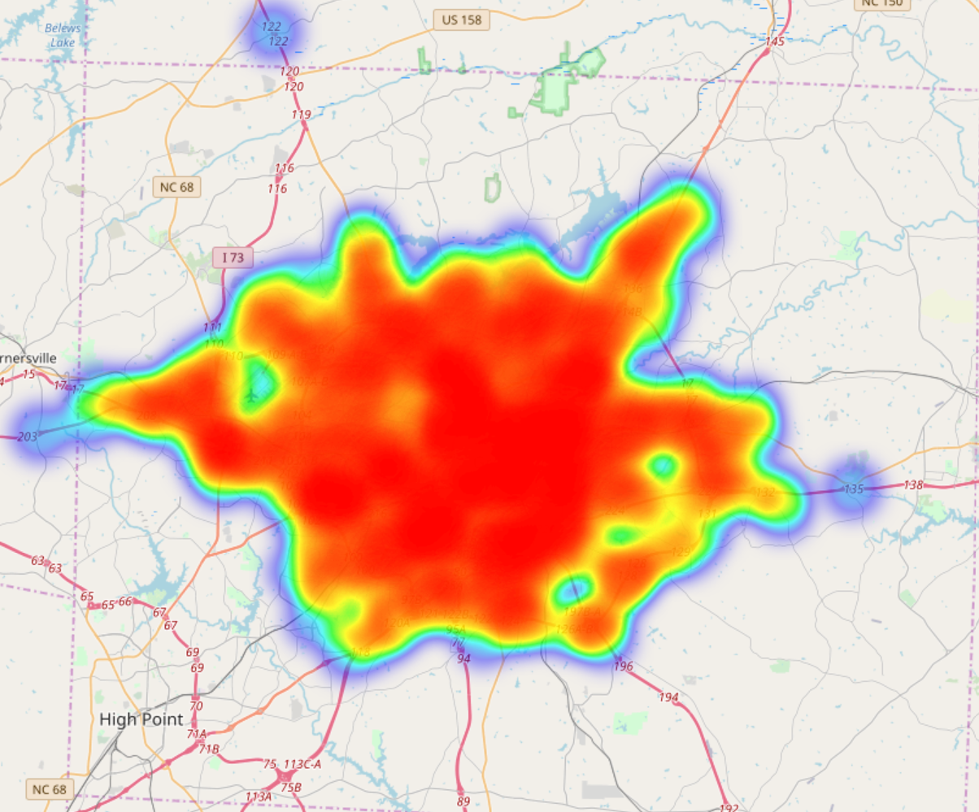
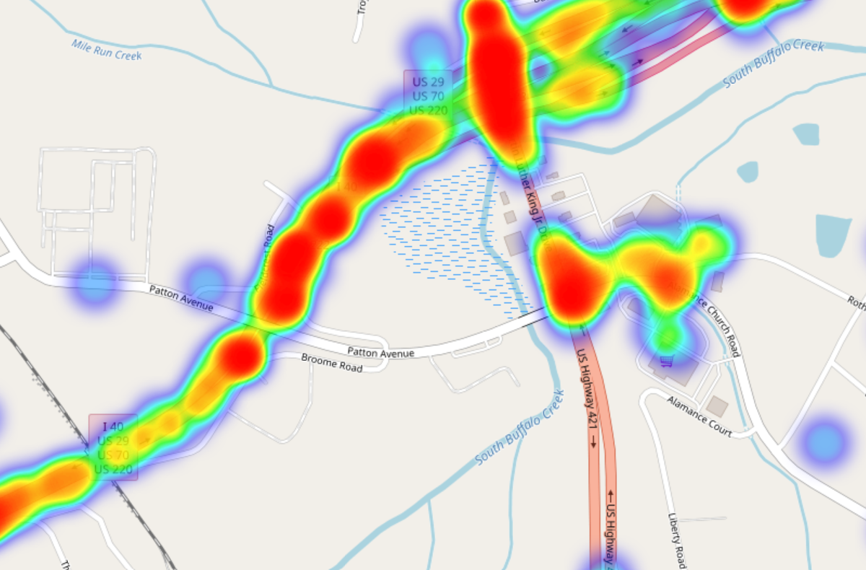
Collisions:2018

Slide 38
Conclusions
The GIS data made it extra difficult to construct the data
The date information needed to be cleaned up to be properly used
Weather data was not associated with the crash data when it should have, it would have made the analysis a lot easier
Overall we were able to make some correlations and distributions given the data,
but more analysis is needed to make a reliable conclusion on anything.

